Slide 1
Robust and Secure Feedback Control For Queueing Networks
Qian Xie
qx66@cornell.edu
Joint work with Li Jin, mostly done at NYU

Slide 2
Outline
Background of queueing model
Robust control for Jackson network (published in IEEE-TCNS)
Secure control for parallel queues (working paper)

Slide 3
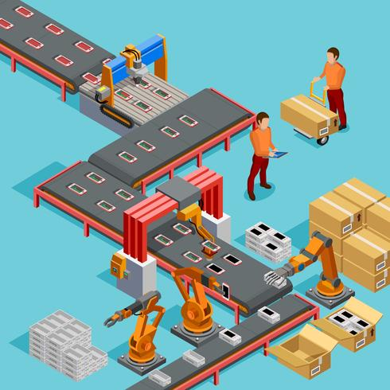
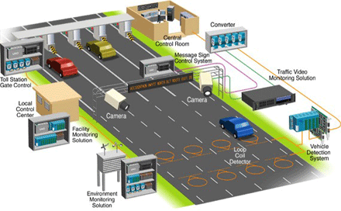
Queueing model
What it captures: queueing due to random arrival and/or random service time
What it not captures: demand & capacity fluctuations
Queueing control: routing, sequencing, service rate control, admission control
Applications: transportation systems, manufacturing networks (production lines), communication/computer networks

Slide 4
Robust routing for network systems
In practical settings, model data (arrival/service rates) may be
unavailable
hard to estimate
vary over time
Suppose that we know the topology of a network, but do not know the demand and supply/capacity

Slide 5
Learning-based vs. robust control
How to make decisions in an unknown environment?
Solution 1: learn the environment from observation
learning-based adaptive control
efficient & smart
requires sufficient data
vulnerable to unhealthy data
Solution 2: independent of environment parameters
robust control
easy & robust
guarantee stability but not efficiency
resist modeling error and/or non-stationary environment
Solution 2 motivates model-based independent control

Slide 6
Formulation
Multi-class Jackson queueing network with Poisson arrivals & exponential service times
Multiple origins, multiple destinations, acyclic
Real-time OD-specific queue sizes can be observed
Control actions: routing, sequencing, and holding
Arrival and service rates unknown

Slide 7
Join the shortest queue
Simple case: parallel queues
Intuitive routing policy: join the shortest queue (JSQ)
route the arrival to the shortest queue
ties are broken uniformly at random
Standard results:
System is stable if and only if arrival rate < total service rate
Optimal for symmetric servers
MDI: no info about arrival/service rates are needed
Throughput-maximizing: if demand < capacity, then system is stable

Slide 8
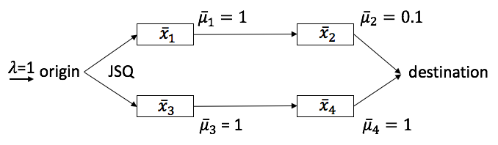
JSQ fails for networks
Can we extend JSQ to networks? No!
By symmetry & Burke’s theorem, departure process from servers 1 & 3 are both Poisson of rate 0.5
However, 0.5 exceeds the service rate of server 2 (0.1)
Thus, the network is unstable!

Slide 9
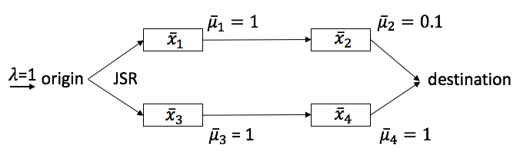

Solution: join the shortest route
Why JSQ fails?
Server 2 will be congested, but such information is not used at the origin
To fix this, consider the total queue sizes on each route:
Join queue 1 if $\overline{x}1+\overline{x}2<\overline{x}3+\overline{x}4$
Join queue 3 if $\overline{x}1+\overline{x}2>\overline{x}3+\overline{x}4$
Ties broken uniformly at random
Improve JSQ to JSR

Slide 10

How about more complex networks?
What if the network is not parallel/serial?
Consider expanded network
Then the previous route-sum is not easy to extend.
We consider an alternative:
$y_{1}=max⁡\{x_{1a},{\frac{1}{2}(x}_{1a}+x_{2})\}, y_{2}=max⁡\{x_{1b},{\frac{1}{2}(x}_{1b}+x_{3}),{\frac{1}{3}(x}_{1b}+x_{3}+x_{5a})\}$, $y_{3}=max⁡\{x_{4},{\frac{1}{2}(x}_{4}+x_{5b})\}$

Slide 11

Multi-class centralized control
Join the shortest ”route”: $\min_{k}{ y}_{k}$
This applies to multi-class (multi-OD) traffic
Centralized control: requires global information
JSR is model-data independent

Slide 12
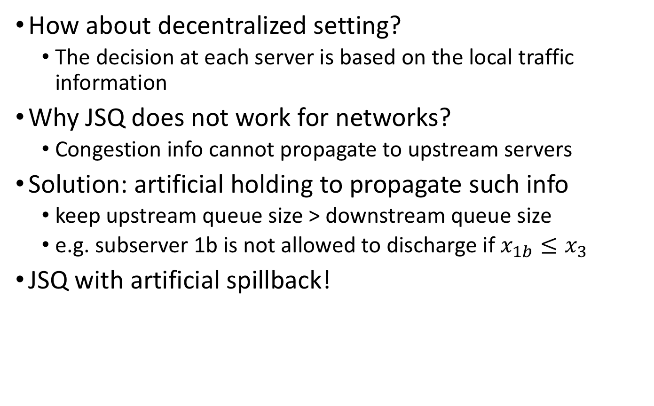
Single-class decentralized control
How about decentralized setting?
The decision at each server is based on the local traffic information
Why JSQ does not work for networks?
Congestion info cannot propagate to upstream servers
Solution: artificial holding to propagate such info
keep upstream queue size > downstream queue size
e.g. subserver 1b is not allowed to discharge if $x_{1b}≤x_{3}$
JSQ with artificial spillback!

Slide 13
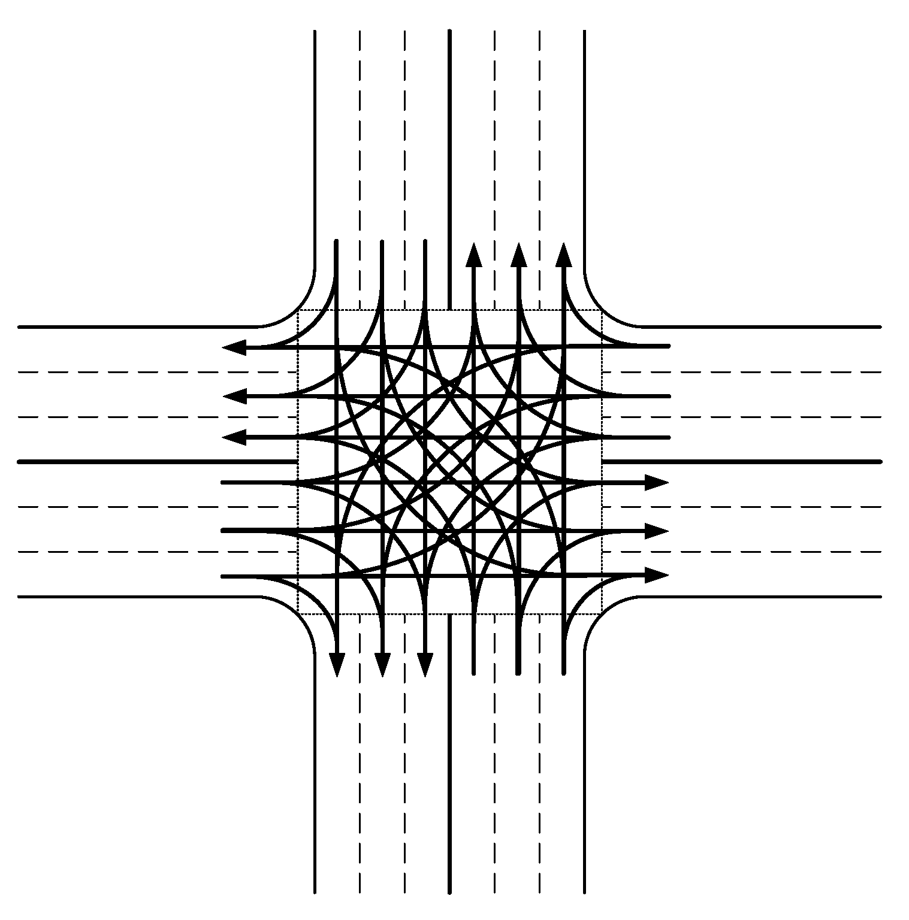
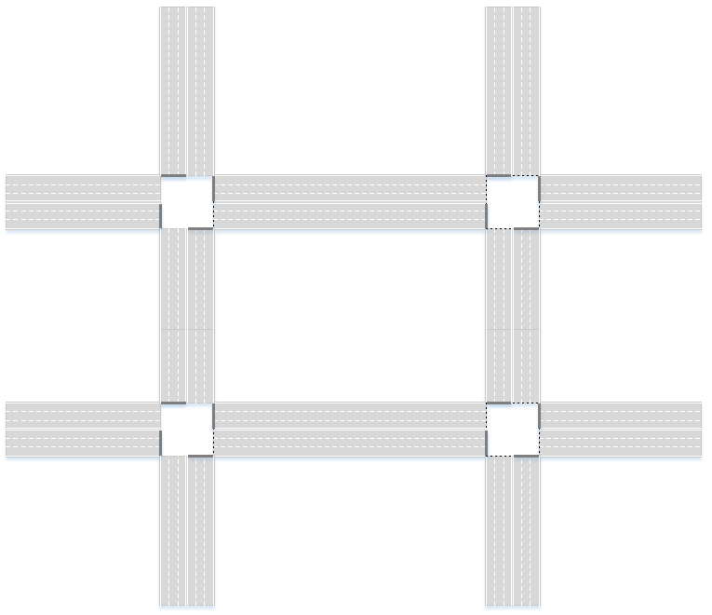
Application to district routing
Find routes for all CAVs in a district
Objective: minimize the average traveling time of CAVs
Actions: assigning routes to CAVs
Constraints:
Physical constraints/sequencing in the driving environment (AIM, CAV moving…)
CAVs has their own source and destination

Slide 14
Training of RL
Joint work with NYU ECE High Speed Networking Lab
Routes for all CAVs
Routing Algorithm
(Reinforcement Learning)
minimize the traveling time
State
M/D/1 network
Reward
Driving environment

Slide 15
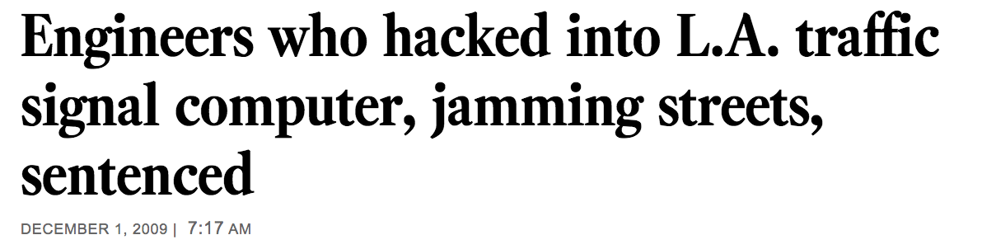

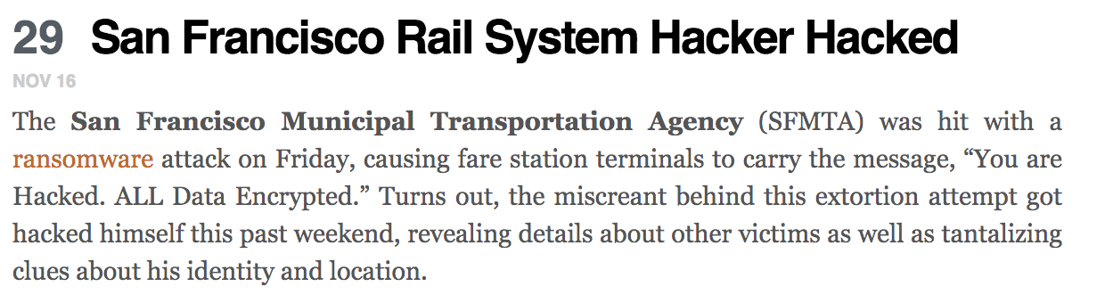
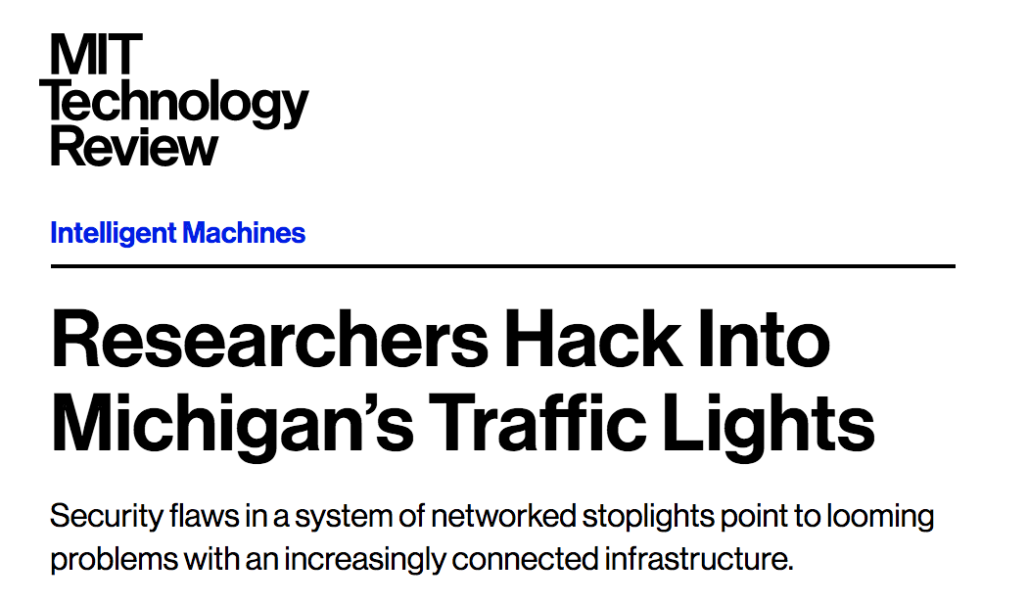
Security risks in network systems
Network systems rely on data collection and transmission
Intelligent transportation systems (ITSs)
Manufacturing systems (production lines)
Communication networks
Cyber components susceptible to data loss and data errors
E.g., traffic sensors and traffic lights can be intruded and manipulated
Need secure-by-design features
Notes:
Network systems rely on data collection and data transmission. However, the lack of secure-by-design features makes them susceptible to data loss and data errors. For example, in intelligent transportation systems, researchers have found that traffic sensors and traffic lights can be easily intruded and manipulated. Also, news reported that an artist used 99 phones to fake a traffic jam on Google Maps. We can expect that in the near future, hackers may spoof traffic sensor data or create phantom traffic jams in navigation apps for selfish or malicious intent (e.g., leading other vehicles to take a different road). Similar security risks also exist in manufacturing systems and communication networks.

Slide 16
Example: dynamic routing in ITSs
Notes:
This is a simple example to illustrate the security risks in intelligent transportation systems. Consider parallel roads from an origin to a destination. The system operator routes each arriving vehicle to one of the links according to real-time traffic condition. However, such observations can be attacked by some malicious adversaries and the system operator has resources to secure or recover the observations. The resources may be limited or costly, so the system operator has to make careful decisions.

Slide 17
Research questions
Modeling & analysis
How to model stochastic & recurrent faults/attacks?
How to quantify attacker’s incentive?
How to quantify the impact due to faults/attacks?
How to evaluate various security risks?
Resource allocation
How to allocate limited/costly security resources, including redundant components, diagnosis mechanisms, etc.?
Decision making
How to make protecting (resp. defending) decisions in the face of random faults (resp. malicious attacks)?
Notes:
Now, to address such issues, we develop the following research questions. How to … As far as we know, they have not been well studied in conjunction with the dynamics of the network systems, which is typically modeled as queuing processes.

Slide 18
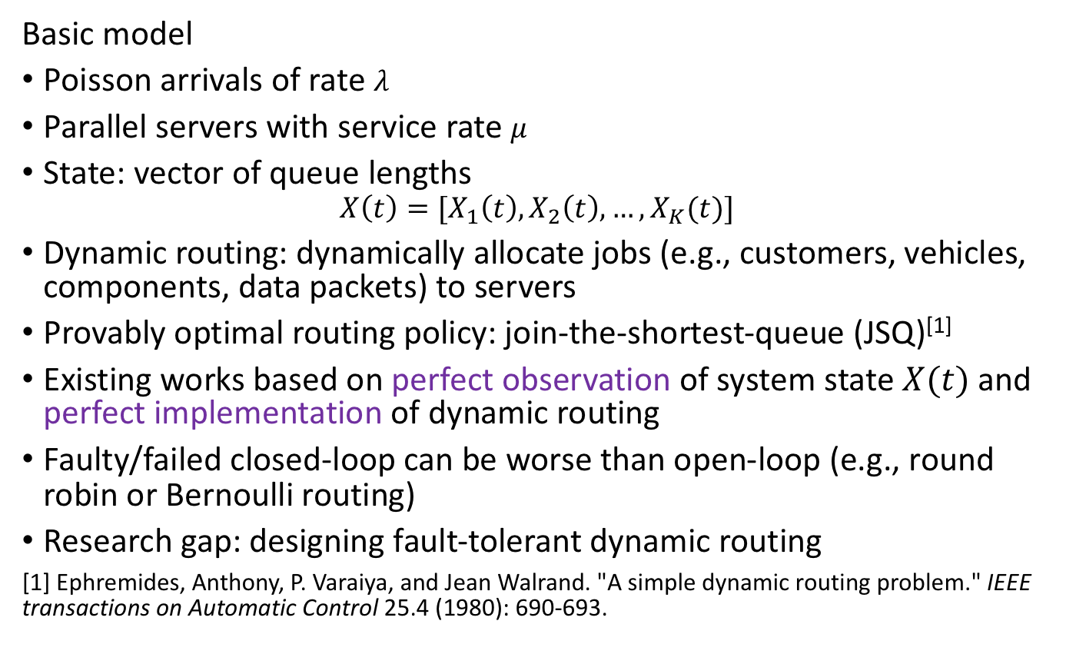
Parallel-queueing system
$$x_{1}(t)$$
Basic model
Poisson arrivals of rate $λ$
Parallel servers with service rate $μ$
State: vector of queue lengths
$$X\left(t\right)=[X_{1}\left(t\right),X_{2}\left(t\right),…,X_{K}(t)]$$
Dynamic routing: dynamically allocate jobs (e.g., customers, vehicles, components, data packets) to servers
Provably optimal routing policy: join-the-shortest-queue (JSQ)^{[1]}
Existing works based on perfect observation of system state $X(t)$ and perfect implementation of dynamic routing
Faulty/failed closed-loop can be worse than open-loop (e.g., round robin or Bernoulli routing)
Research gap: designing fault-tolerant dynamic routing
[1] Ephremides, Anthony, P. Varaiya, and Jean Walrand. "A simple dynamic routing problem." IEEE transactions on Automatic Control 25.4 (1980): 690-693.
$$μ$$
$$x_{2}(t)$$
$$μ$$
$$λ$$
$$s$$
$$t$$
$$μ$$
$$x_{3}(t)$$
Notes:
To start from scratch, we consider a parallel queuing system with Poisson arrivals and symmetric servers. We are specifically interested in dynamic routing with security risks. The idea of dynamic routing is dynamically allocating jobs to servers. Jobs can be vehicles in transportation system, components on production lines and data packets in computer networks. It has been proved that without failures, the send-to-shortest-queue policy is optimal if the system operator has perfect observation of the system state, i.e. the vector of queue lengths and perfect implementation of the dynamic routing. However, if the observation is imperfect, there is chance that the send-to-shortest-queue policy is even worse than open-loop routing policies such as Bernoulli routing policy.

Slide 19
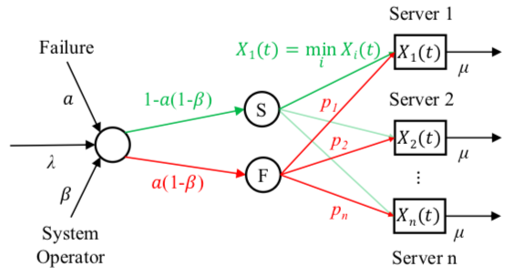
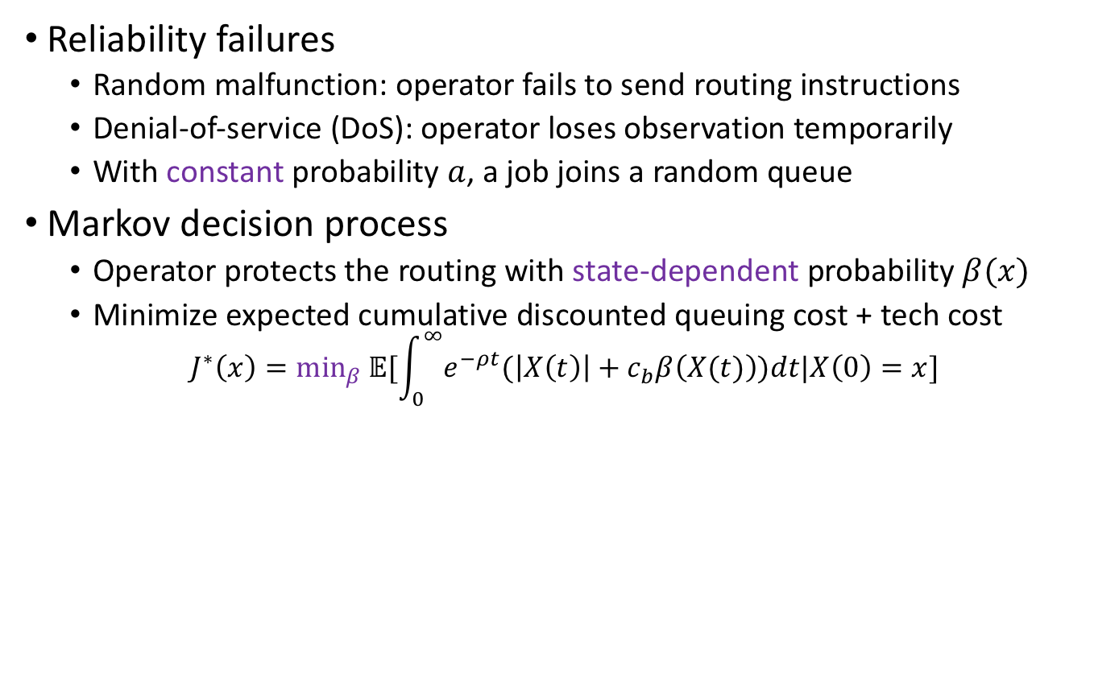
Protection against reliability failures
Reliability failures
Random malfunction: operator fails to send routing instructions
Denial-of-service (DoS): operator loses observation temporarily
With constant probability $a$, a job joins a random queue
Markov decision process
Operator protects the routing with state-dependent probability $β(x)$
Minimize expected cumulative discounted queuing cost + tech cost
$$J^{∗}\left(x\right)=\min_{β} 𝔼[\int_{0}^{∞}{e^{−ρt}(\left|X\left(t\right)\right|+c_{b}β\left(X(t)\right))dt|X\left(0\right)=x}]$$
Notes:
In this work, we consider two types of failure modes. The first one is the reliability failures, say random malfunction that makes the jobs fail to receive routing instructions from the system operator and the DoS attack that cuts off the system operator’s observation. With constant probability $a$, a job joins a random queue, with equal or nonequal probabilities.
We model the system operator’s decision-making problem as a Markov decision process. For each arrival, the operator protects the routing with state-dependent probability $β(x)$. Following the protected routing, a job can definitely be allocated to the shortest queue.
Technological costs including human labor and investments in software/hardware

Slide 20
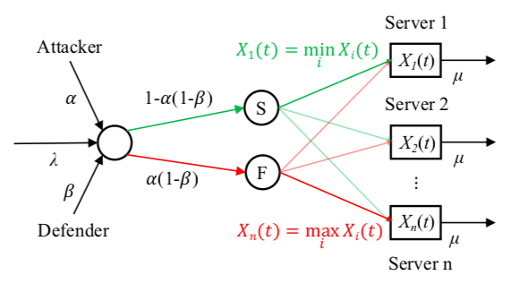
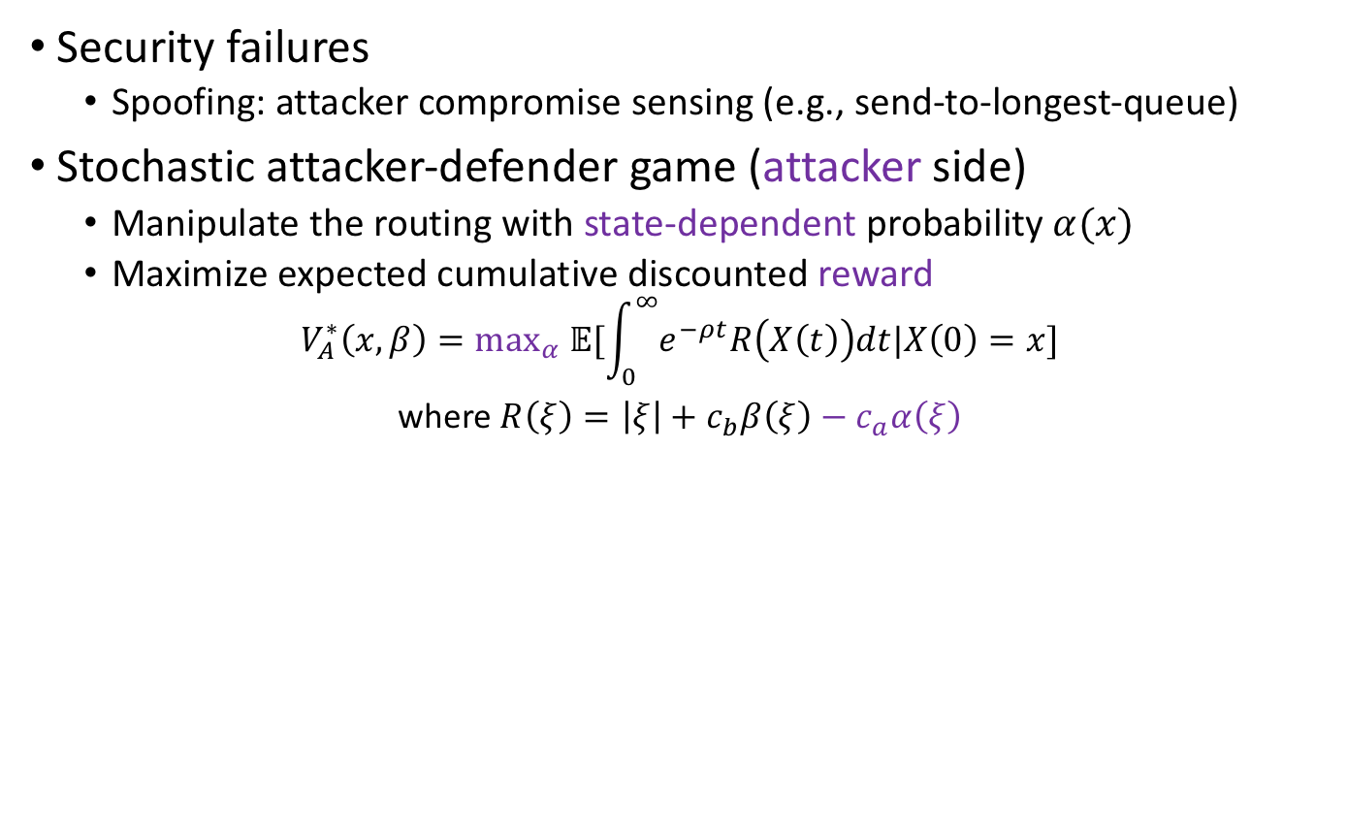
Defense against security failures
Security failures
Spoofing: attacker compromise sensing (e.g., send-to-longest-queue)
Stochastic attacker-defender game (attacker side)
Manipulate the routing with state-dependent probability $α(x)$
Maximize expected cumulative discounted reward
$$V_{A}^{∗}\left(x,β\right)=\max_{α} 𝔼[\int_{0}^{∞}{e^{−ρt}R\left(X\left(t\right)\right)dt|X\left(0\right)=x}]$$
where $R\left(ξ\right)=\left|ξ\right|+c_{b}β\left(ξ\right)−c_{a}α\left(ξ\right)$
Notes:
The second one is the security failures, say the spoofing that can manipulate the system operator’s observation or instruction. Now we formulate the interaction between the attacker and the system operator as a stochastic attacker-defender game.

Slide 21
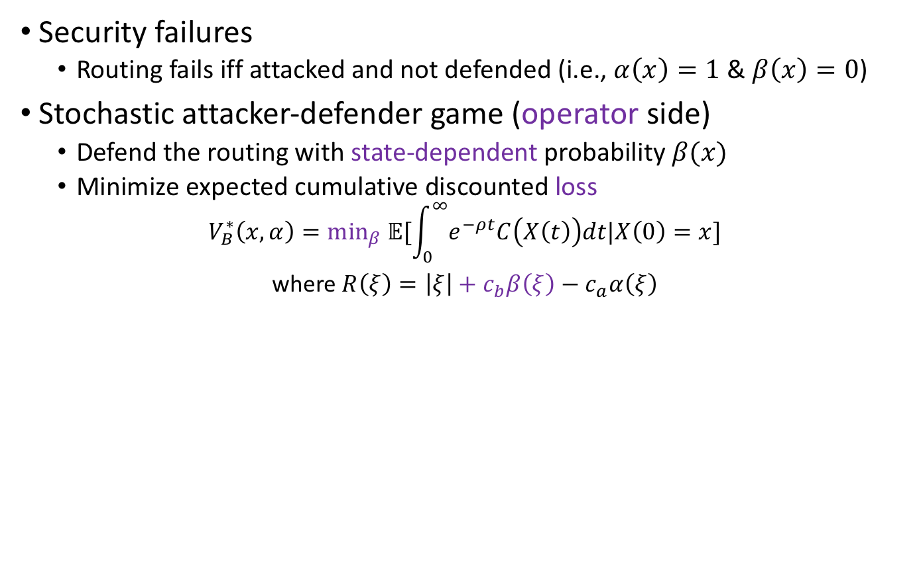
Defense against strategic attacks (cont’d)
Security failures
Routing fails iff attacked and not defended (i.e., $α\left(x\right)=1$ & $β\left(x\right)=0$)
Stochastic attacker-defender game (operator side)
Defend the routing with state-dependent probability $β(x)$
Minimize expected cumulative discounted loss
$$V_{B}^{∗}\left(x,α\right)=\min_{β} 𝔼[\int_{0}^{∞}{e^{−ρt}C\left(X\left(t\right)\right)dt|X\left(0\right)=x}]$$
where $R\left(ξ\right)=\left|ξ\right|+c_{b}β\left(ξ\right)−c_{a}α\left(ξ\right)$

Slide 22
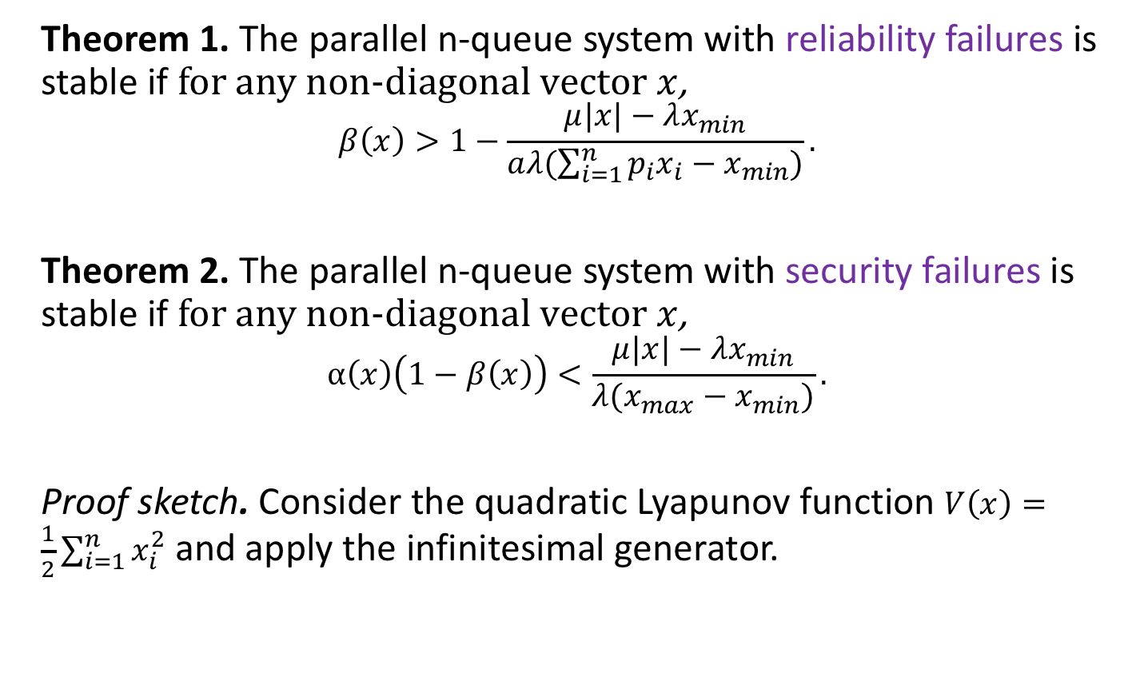
Stability criteria
Theorem 1. The parallel n-queue system with reliability failures is stable if for any non-diagonal vector $x$,
$$β\left(x\right)>1−\frac{μ|x|−λx_{min}}{aλ(\sum_{i=1}^{n}{p_{i}x_{i}}−x_{min})}.$$
Theorem 2. The parallel n-queue system with security failures is stable if for any non-diagonal vector $x$,
$$α\left(x\right)\left(1−β\left(x\right)\right)<\frac{μ|x|−λx_{min}}{λ(x_{max}−x_{min})}.$$
Proof sketch. Consider the quadratic Lyapunov function $V\left(x\right)=\frac{1}{2}\sum_{i=1}^{n}{x_{i}^{2}}$ and apply the infinitesimal generator.
Notes:
We know that without failures, a n-queue system is stable if and only if the demand is less than the total capacity, i.e. λ < nµ. However, even this condition is satisfied, reliability and security failures can still destabilize the queuing system. Therefore, we have to add more conditions to the stability criteria.

Slide 23
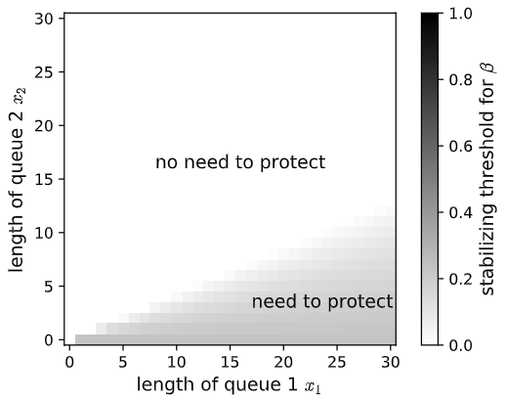

Stability criteria (cont’d)
Theorem 1. The parallel n-queue system with reliability failures is stable if for any non-diagonal vector $x$,
$$β\left(x\right)>1−\frac{μ|x|−λx_{min}}{aλ(\sum_{i=1}^{n}{p_{i}x_{i}}−x_{min})}.$$
Characterization of the stabilizing threshold:
$$p_{1}=0.1,p_{2}=0.9,λ=1.6,μ=1,a=0.9$$
Notes:
For example, under this set of parameter, when observing queue lengths as in the shadow area, if the system operator not protects, then the system can be destabilized.

Slide 24
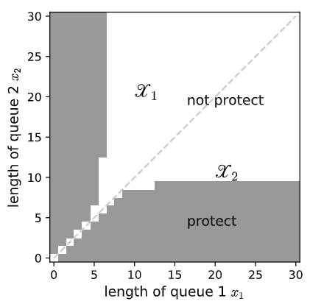

Optimal protecting policy
Theorem 3. Consider a parallel n-queue system with reliability failures. The optimal protecting policy $β^{∗}(x)$ is threshold-based.
Bang-bang control: operator either protects or does not protect (no probabilistic protection), i.e., $β^{∗}\left(x\right)∈\{0,1\}$
Operator needs to protect when 1) the queue lengths are less ‘‘balanced’’; (2) the queues are close to empty
Proof idea: HJB equation and induction on value iteration.

Slide 25
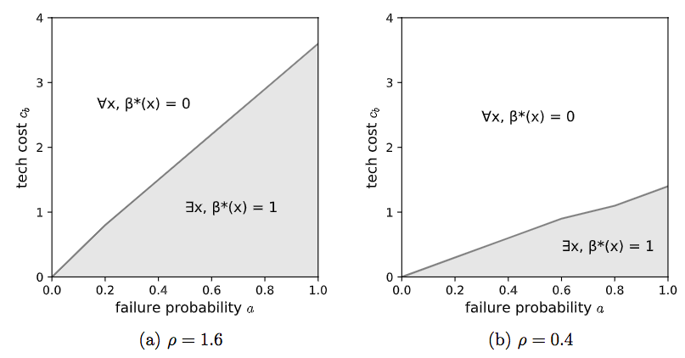

Numerical study
The incentive to protect is non-decreasing in the failure probability $a$, non-increasing in the tech cost $c_{b}$, and non-decreasing in the throughput $λ$ (estimation of the optimal protecting policy is based on the truncated policy iteration).
Tipping points when the operator starts to protect “riskier states”

Slide 26
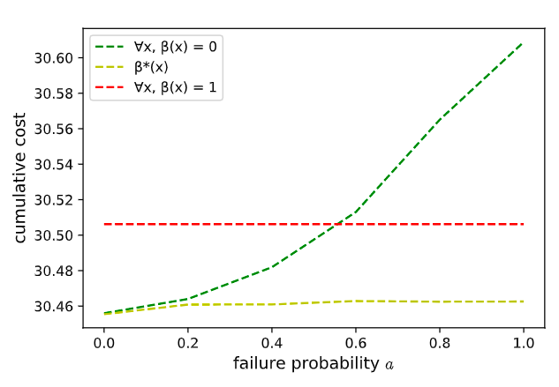

Numerical study (cont’d)
Simulation result: the optimal closed-loop protecting policy $β^{∗}$ performs better in terms of the cumulative cost, compared to the open-loop policies (benchmark) never defend and always defend.

Slide 27
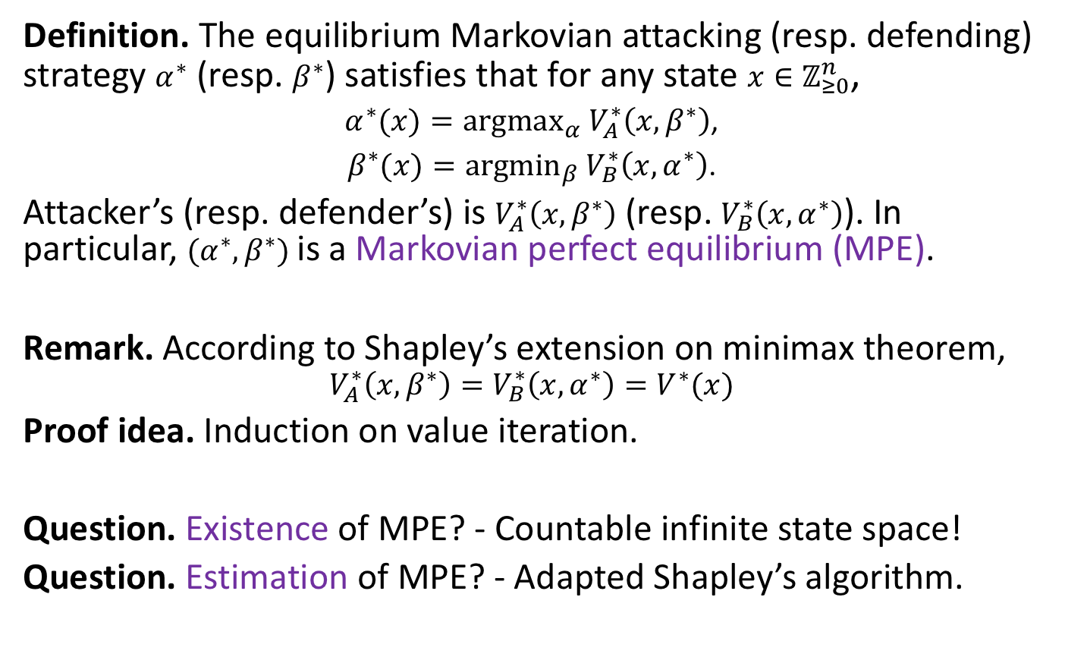
Attacker-defender game
Definition. The equilibrium Markovian attacking (resp. defending) strategy $α^{∗}$ (resp. $β^{∗}$) satisfies that for any state $x∈ℤ_{≥0}^{n}$,
$α^{∗}(x)={argmax}_{α}$ $V_{A}^{∗}\left(x,β^{∗}\right)$,
$β^{∗}(x)={argmin}_{β}$ $V_{B}^{∗}\left(x,α^{∗}\right)$.
Attacker’s (resp. defender’s) is $V_{A}^{∗}\left(x,β^{∗}\right)$ (resp. $V_{B}^{∗}\left(x,α^{∗}\right)$). In particular, $(α^{∗},β^{∗})$ is a Markovian perfect equilibrium (MPE).
Remark. According to Shapley’s extension on minimax theorem,
$$V_{A}^{∗}\left(x,β^{∗}\right)=V_{B}^{∗}\left(x,α^{∗}\right)=V^{∗}(x)$$
Proof idea. Induction on value iteration.
Question. Existence of MPE? - Countable infinite state space!
Question. Estimation of MPE? - Adapted Shapley’s algorithm.

Slide 28
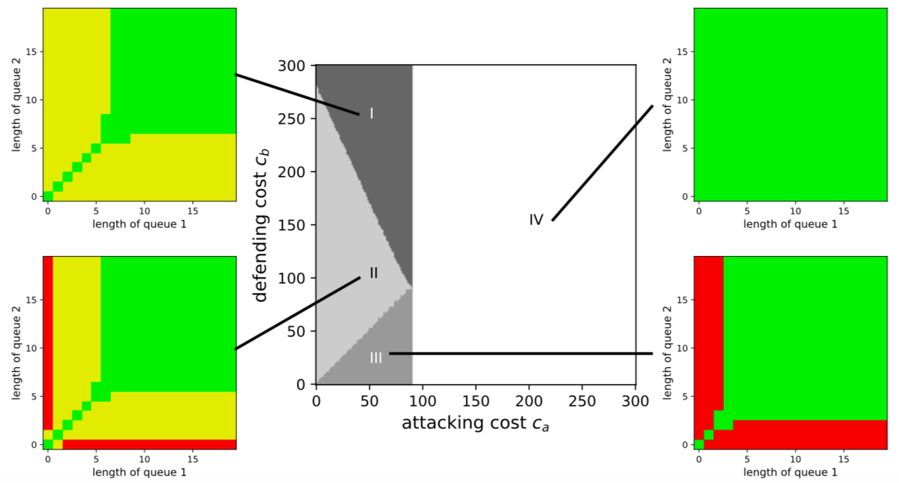

MPE analysis
Theorem 4. The MPE has four regimes depending on $c_{a}, c_{b}$ and $δ^{∗}\left(x\right)=λ(\max_{j}{V^{∗}\left(x+e_{j}\right)}−\min_{j}{V^{∗}\left(x+e_{j}\right)})$. For each MPE, the state space is divided into subsets with different security risk levels:
$S_{1}=\{x|{(α}^{∗}\left(x\right),β^{∗}\left(x\right))=\left(0, 0\right)\}$ (low risk)
$S_{2}=\{x|{(α}^{∗}\left(x\right),β^{∗}\left(x\right))=\left(1, 0\right)\}$(medium risk)
$S_{3}=\{x|{(α}^{∗}\left(x\right),β^{∗}\left(x\right))=(\frac{c_{b}}{δ^{∗}(x)}, 1−\frac{c_{a}}{δ^{∗}(x)})\}$ (high risk)
Notes:
As for the regimes of the Markovian perfect equilibria, there are three cases depending on the technological costs: (0,0), (1,0) and somewhere in the middle.

Slide 29
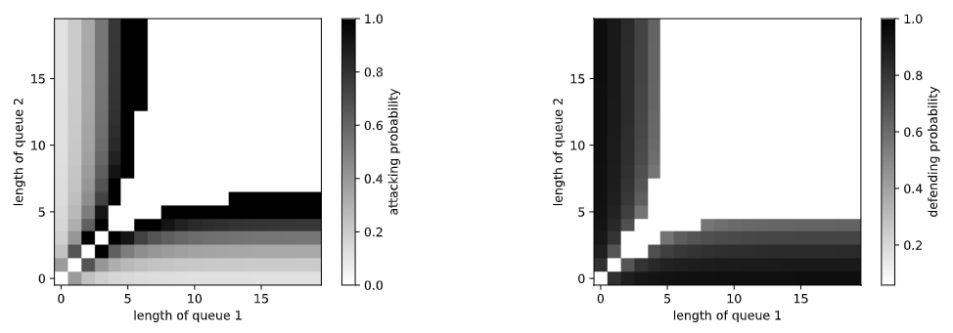



MPE analysis (cont’d)
Theorem 4. The MPE has the following regimes depending on $c_{a}, c_{b}$ and $δ^{∗}\left(x\right)=λ(\max_{j}{V^{∗}\left(x+e_{j}\right)}−\min_{j}{V^{∗}\left(x+e_{j}\right)})$
$δ^{∗}(x)≤c_{a}⇒S_{1}=\{x|{(α}^{∗}\left(x\right),β^{∗}\left(x\right))=\left(0, 0\right)\}$ (low risk)
$c_{a}<δ^{∗}(x)≤c_{b}⇒S_{2}=\{x|{(α}^{∗}\left(x\right),β^{∗}\left(x\right))=\left(1, 0\right)\}$(medium risk)
$δ^{∗}(x)≥{max⁡(c}_{a},c_{b})>0⇒S_{3}=\{x|{(α}^{∗}\left(x\right),β^{∗}\left(x\right))=(\frac{c_{b}}{δ^{∗}(x)}, 1−\frac{c_{a}}{δ^{∗}(x)})\}$
The equilibrium strategies $α^{∗} ,$ $β^{∗}$are both threshold-based.
(high risk)
$$α^{∗}$$
$$β^{∗}$$

Slide 30
Conclusion
Without secure dynamic routing, random faults and malicious attacks can destabilize the queueing system
The optimal protecting strategy and the equilibrium of attacker-defender game have threshold-properties
The system operator has higher incentive to protect when
the failure probability is higher
the tech cost is lower
the throughput is higher
the queue lengths are less ‘‘balanced’’
the queues are close to empty
Our proposed optimal protecting policy (closed-loop) performs better than the benchmark (open-loop)
Optimal protecting strategy (resp. equilibrium) can be estimated by truncated policy iteration (resp. adapted Shapley’s algorithm)

